Slide 1



ODL BOOTCAMP BEIJING 2015
Dynamic Path Optimization& Topology Display
Group 2
Yi Bai:白易Tsinghua
Peng Huang:黄鹏UESTC
Jie Zhou：周洁 FNIC

Slide 2
Overview
1
Display
Present the network topology, link
state & traffic in web server
2
Dynamic Path Optimization
Depend on the link states, take advantage of ECMP, we
get the best path for distinct service

Slide 3
Architecture
Approaches we’ve tried:
Implemented it with a MD-SAL Module
Modified the original L2Switch

Slide 4
Architecture
SimpleForwarding
getRoute
Routing Module
Original: SPF (default policy)
Replaced by ECMP

Slide 5
Architecture:
Purpose: provide SAL service, ECMP routing
Build and maintain calculating topology
Choose several K shortest routes by yum algorithm
Selected routes based on
Statistical information (port status)collected from North Bound interfaces
Randomly select (make sure the flows are distributed to different paths)
What we’ve done: Randomly select the route or request hashcode

Slide 6
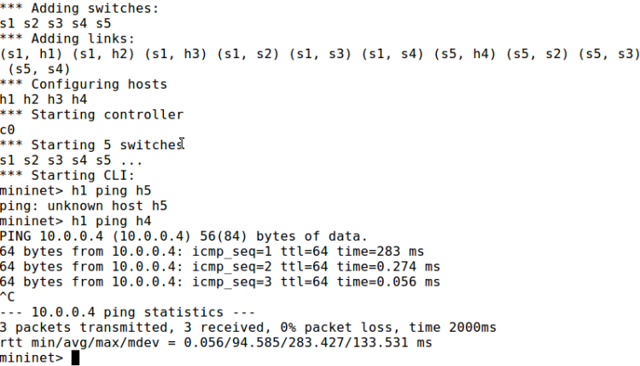
Path Optimization
Result of path optimization

Slide 7
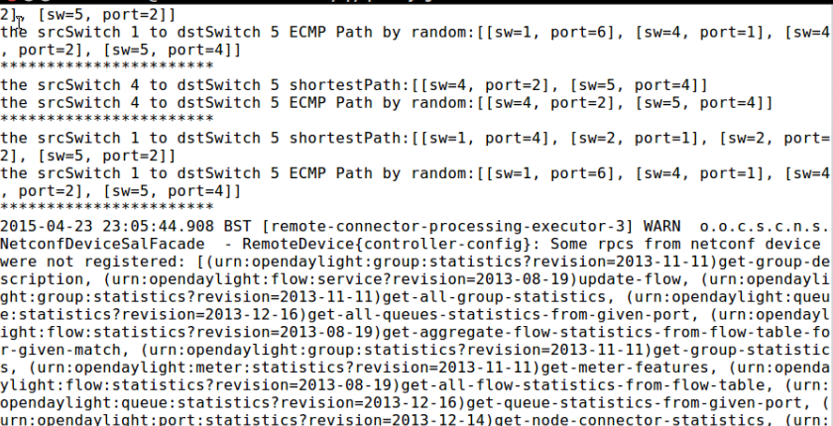
Path Optimization
Result of path optimization

Slide 8
Demo

Slide 9
Display
Display the dynamic changes in topology in short interval
Show how our dynamic path optimization work
Written in JavaScript based on JTopo

Slide 10
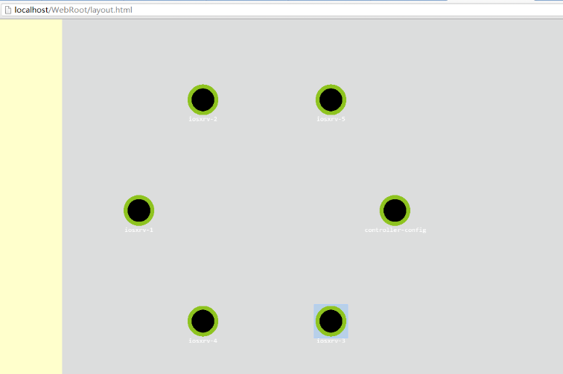
Display
Result of display

Slide 11
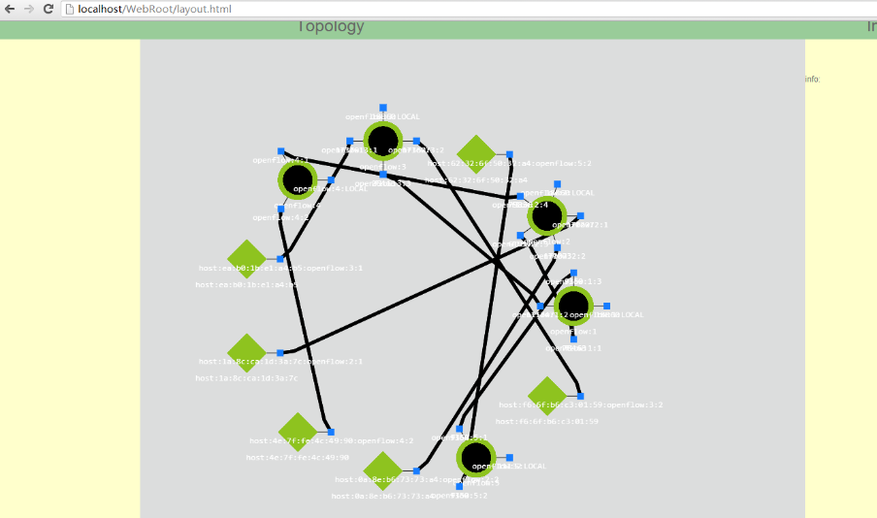
Display
Result of display

Slide 12
ODL BOOTCAMP BEIJING 2015
Enjoy a unique
experience!
Thank You

